Slide 1
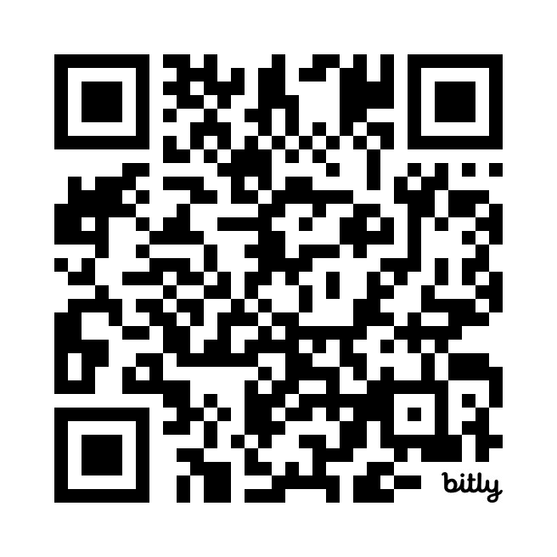

Identity and Access Management Quiz
https://bit.ly/3Wir0yB

